Slide 1

Deployment Automation for Banking Systems
Team Leader:
Nourhan Tarek Gohary
Prepared By:
Ahmed Ashour
Ahmed Mostafa
Ammar Ahmed

Slide 2
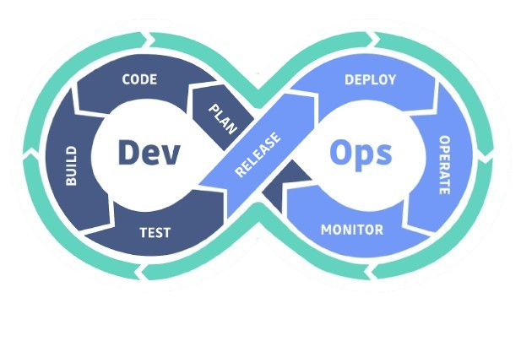
Coming sections
1.What’s DevOps
2.Why DevOps Matters
3.Pre Deployment Check
4.Safe Cleanup
5.Full Backup
6.Smart and Git-Aware Backup
7.Conclusion

Slide 3

1.What’s DevOps
In the world of software, speed and stability are everything.
DevOps is a modern approach that brings developers and operations teams together to build, test, and deliver applications faster and more reliably.
It breaks down silos, automates repetitive work, and ensures that every update is smooth, secure, and customer-ready.

Slide 4
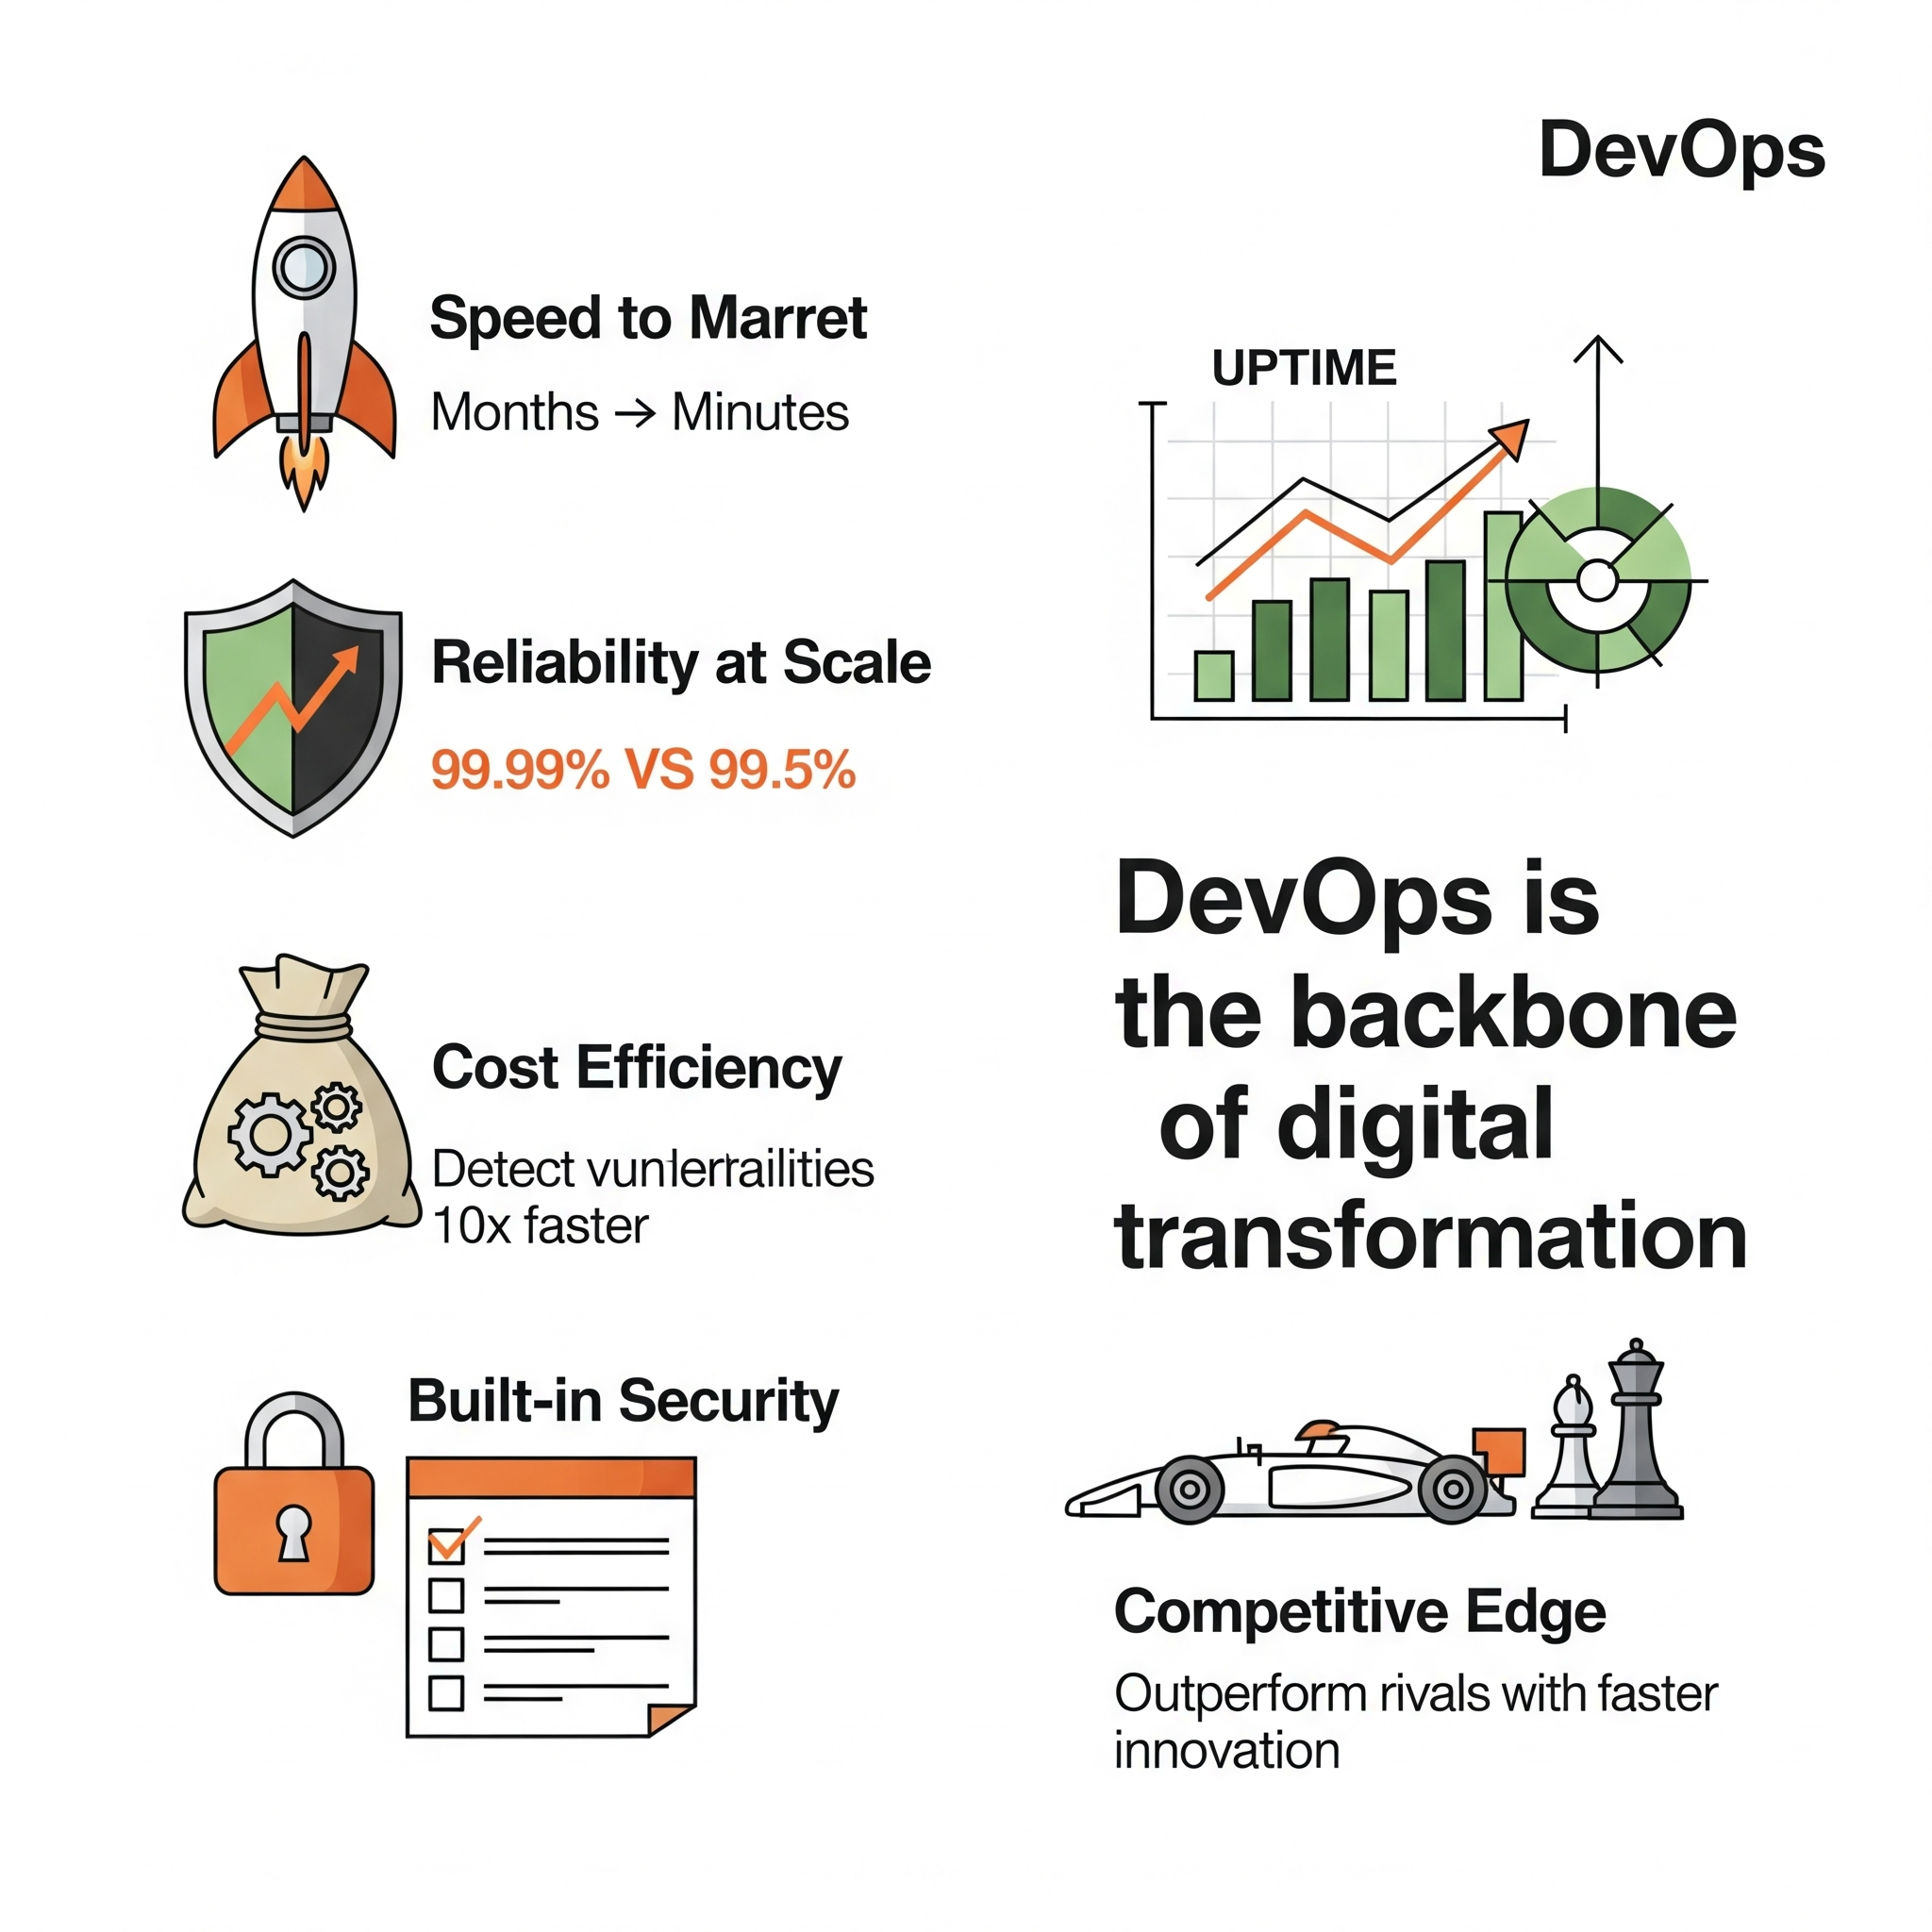
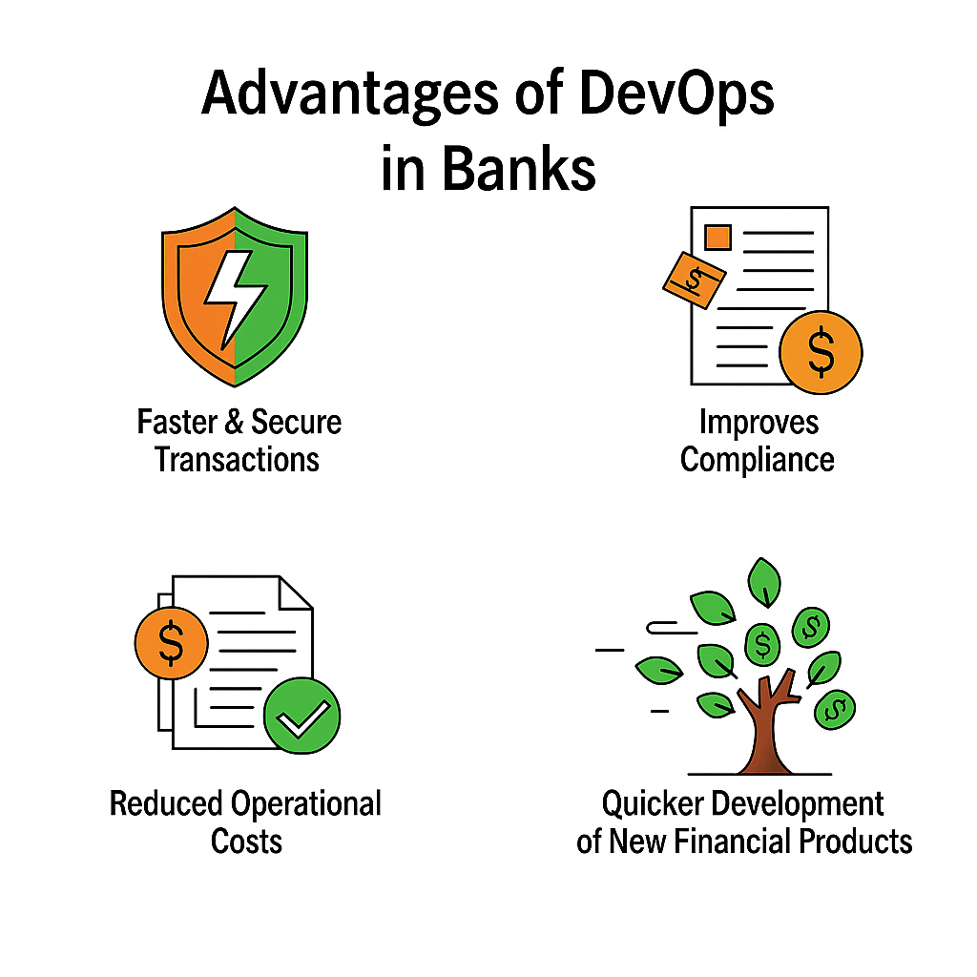
2.Why DevOps matters
In today's digital banking race, DevOps delivers speed, stability, and security—transforming how banks operate. It merges teams and automates workflows to launch features faster while maintaining ironclad compliance. With DevOps, banks achieve 99.99% uptime, recover from incidents in minutes, and prevent costly outages. More than just efficiency, it turns IT into a growth engine—keeping banks ahead of competitors and customers happy.

Slide 5

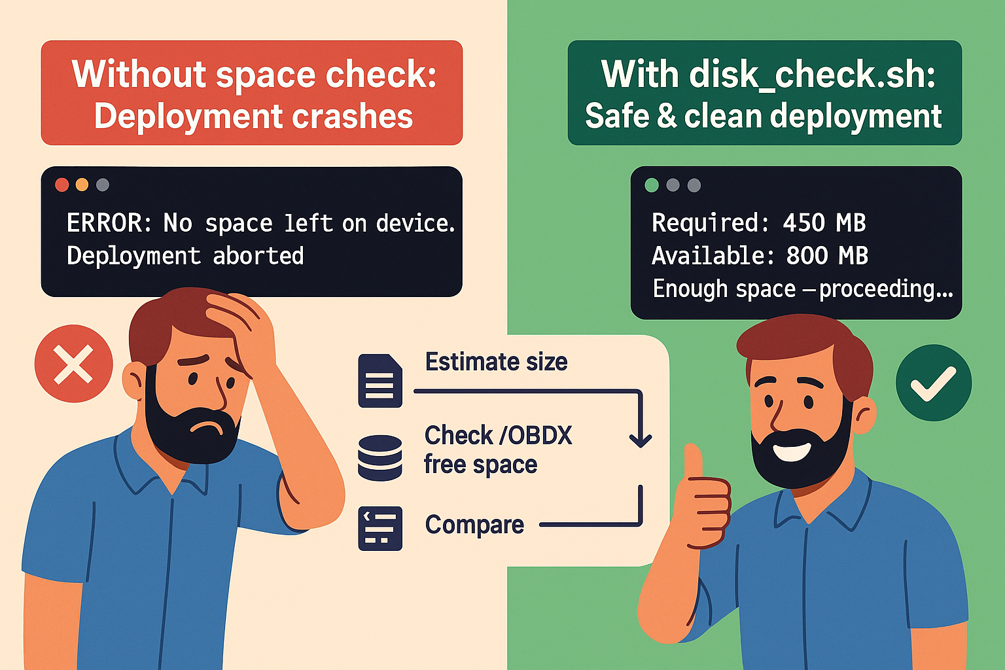

3.Pre-deployment Space Check
Before deploying any release to production—especially in systems like OBDX SIT OHS servers—it's critical to verify there's enough disk space to avoid crashes. This visual compares two scenarios:
🚫 On the left, skipping a space check leads to a failed deployment.
✅ On the right, using a simple script like disk_check.sh ensures enough space, allowing a smooth deployment.

Slide 6

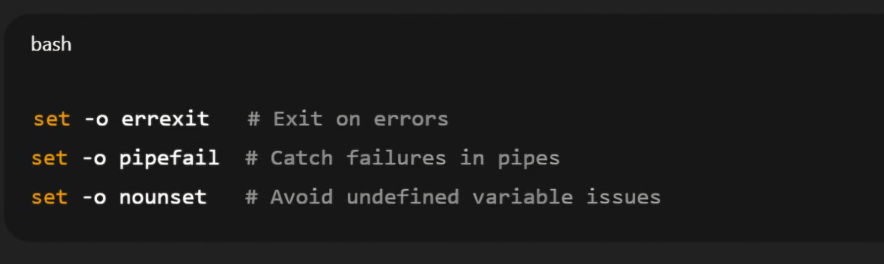
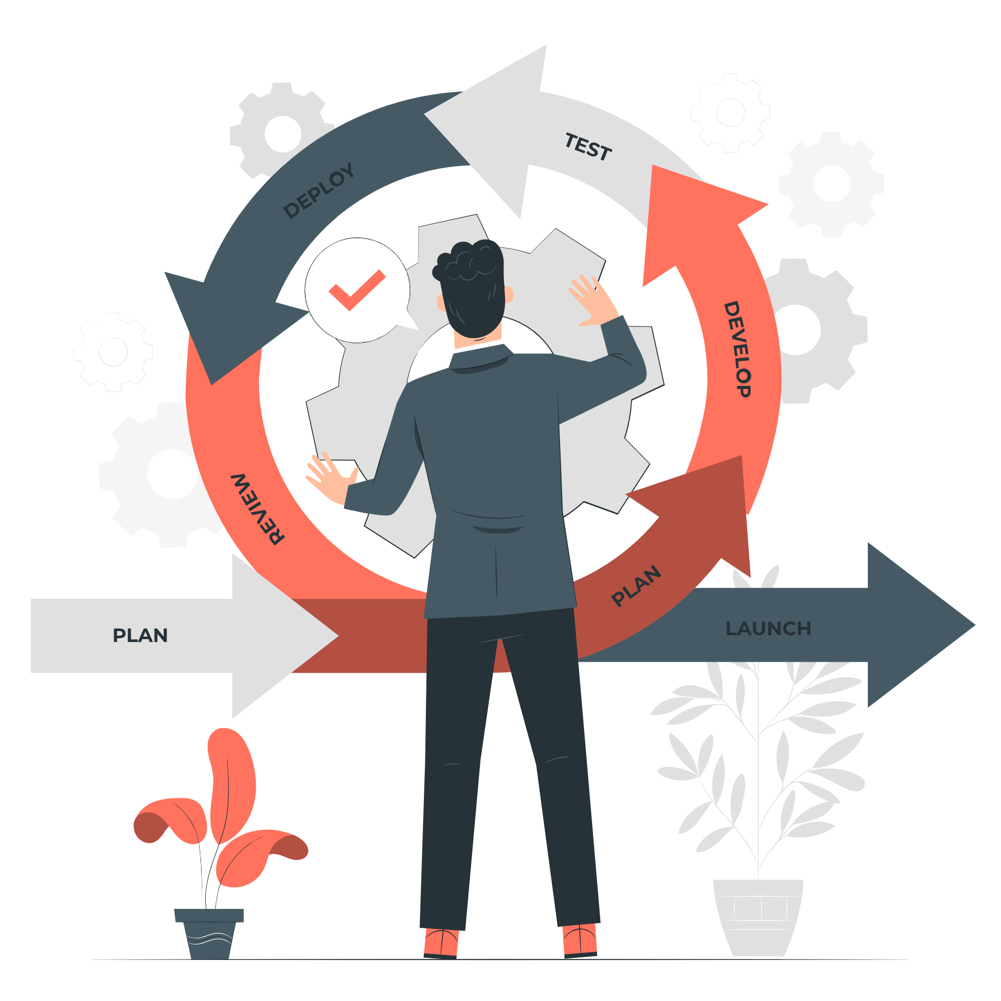
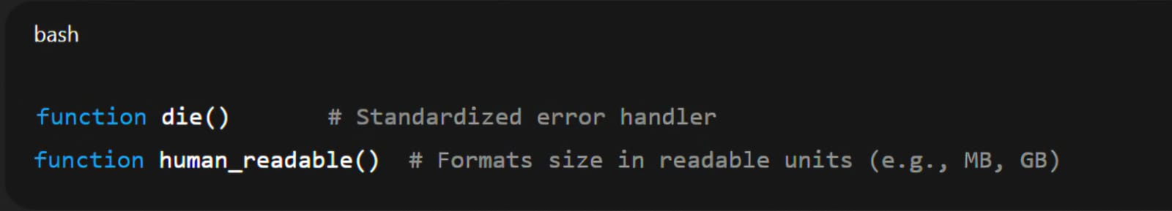
3.Pre-deployment Space Check
We first need to know how much space the release will consume before deploying it:

Slide 7
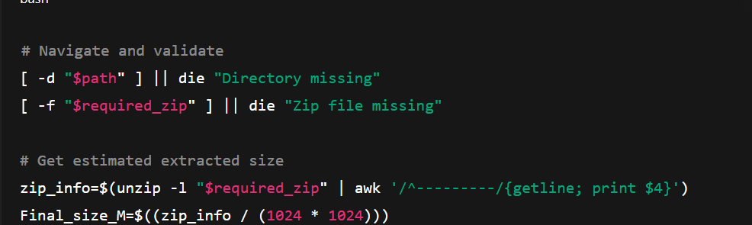

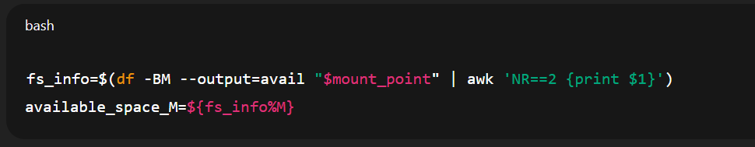
3.Pre-deployment Space Check
Unzips and estimates the required disk space before proceeding.
This ensures /OBDX mount point has enough free megabytes.

Slide 8

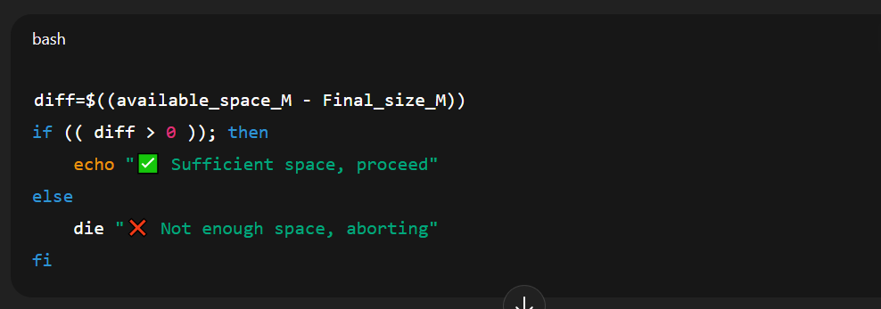

3.Pre-deployment Space Check
Script proceeds or exits gracefully, based on calculated space difference.

Slide 9
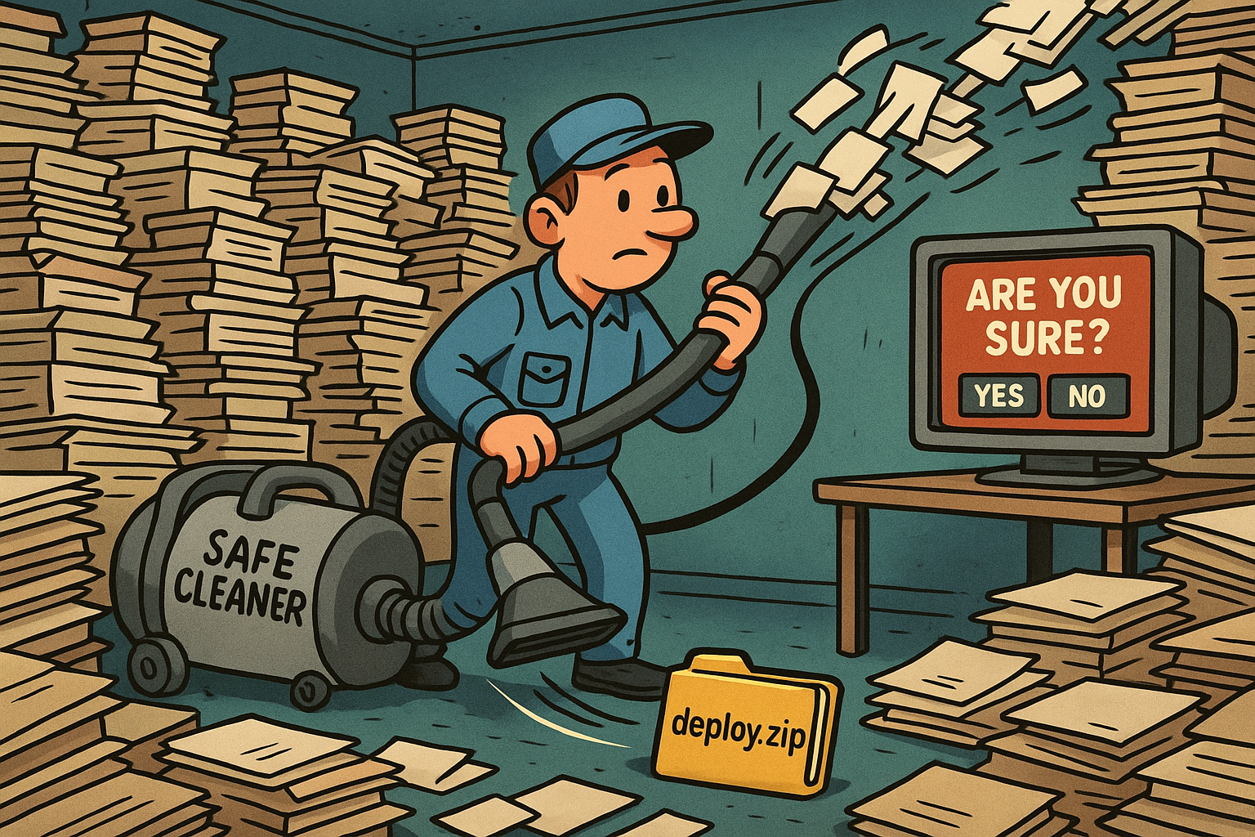
4.Safe Cleanup: The Unsung Hero of Deployment
Before every smooth deployment, there’s a critical backstage process that often goes unnoticed — cleaning up old or unnecessary files.
In enterprise environments like banking platforms (e.g., OBDX), keeping the deployment directory clean ensures:
Faster deployments with fewer errors
More available disk space for future updates
Lower risk of leftover files causing version conflicts
Less manual troubleshooting for DevOps teams
Cleaner rollback points and audit trails

Slide 10
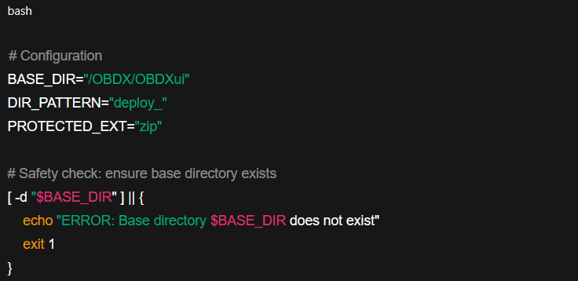


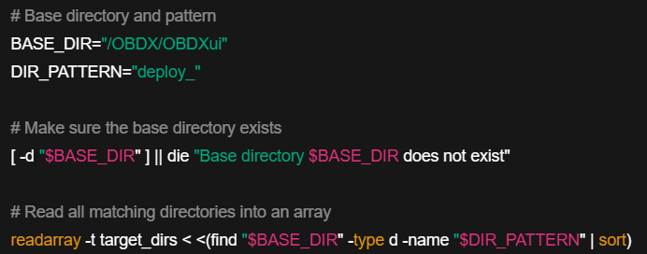
4.Secure Cleanup
Base Configuration and Safety Check
It searches recursively inside /OBDX/OBDXui for any directory with the exact name deploy_, and stores the full paths in the array target_dirs.

Slide 11

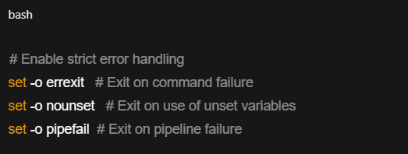

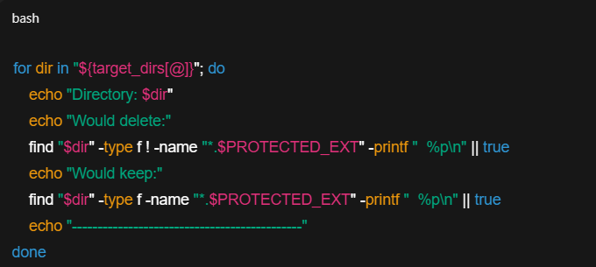
4.Secure Cleanup
If any of these checks fail, the script stops immediately.
It performs a dry run that lists which files in each matched directory would be deleted (all except .zip files) and which ones would be kept (only .zip files), without actually deleting anything.

Slide 12
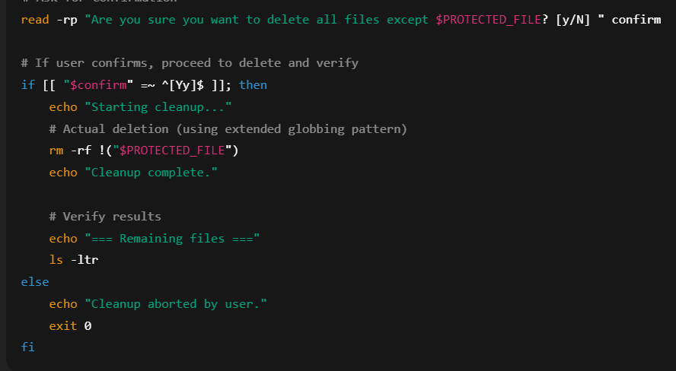


4.Secure Cleanup
Before deleting anything, the script asks the user for final confirmation.
If the user types Y/y, the script deletes all files in the directory except deploy.zip.
If the user answers anything else (or nothing), the script aborts safely—nothing is deleted.

Slide 13
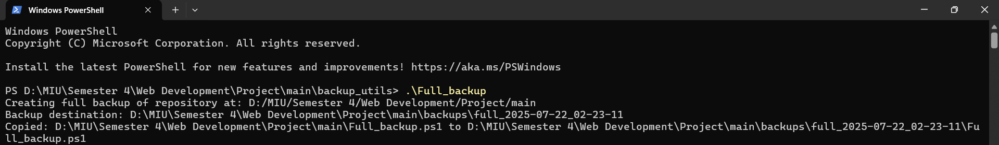

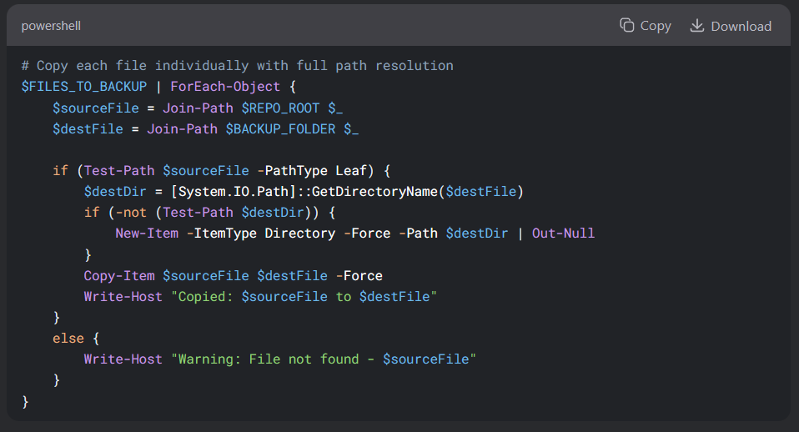

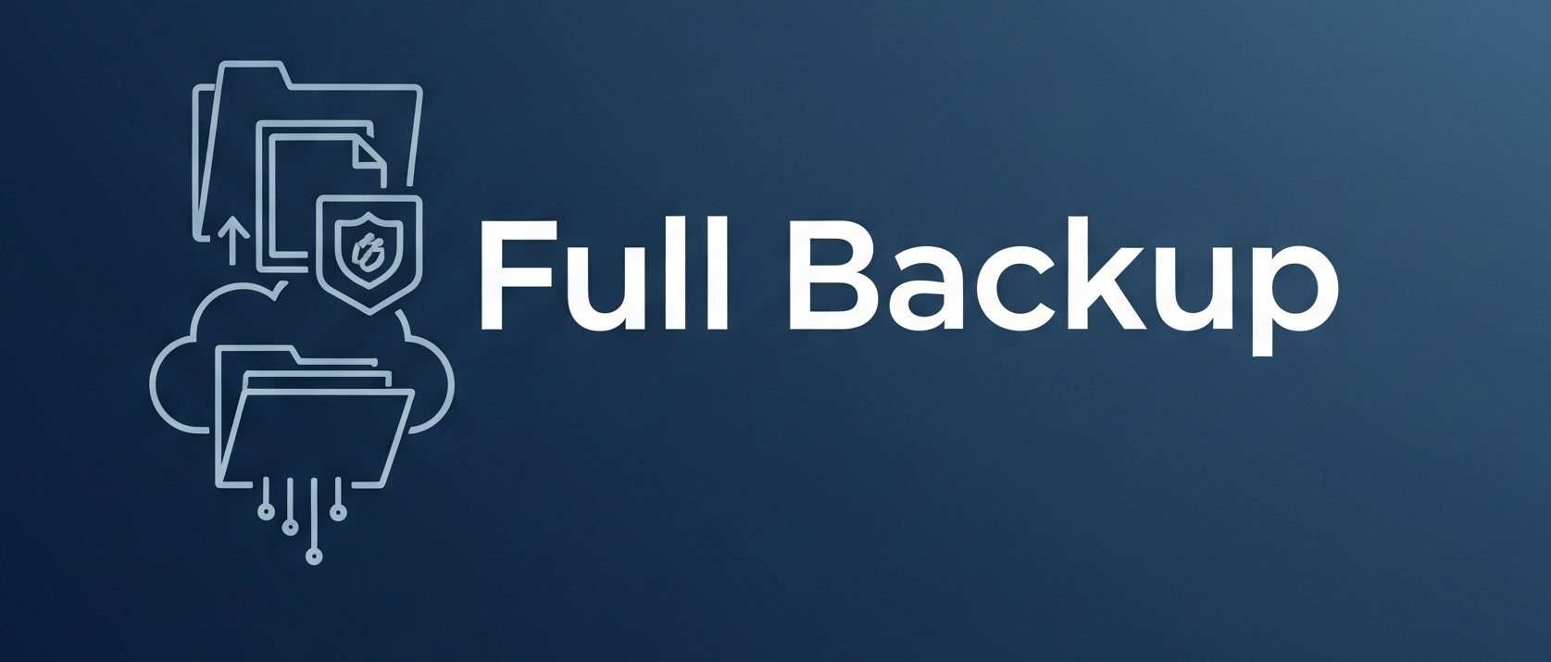
5.Full Backup

Slide 14
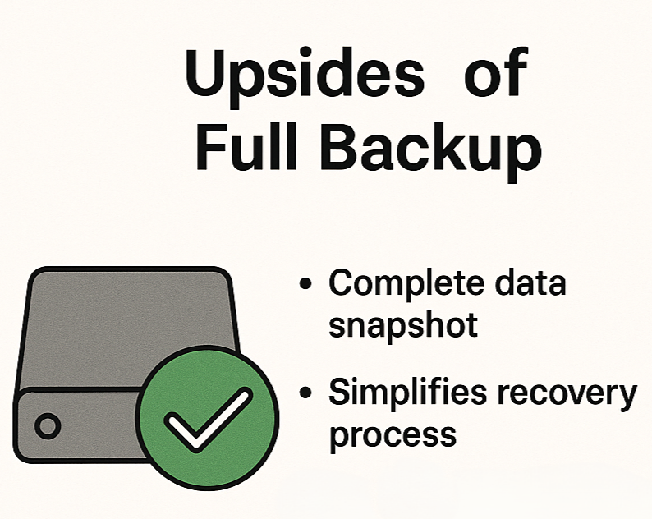
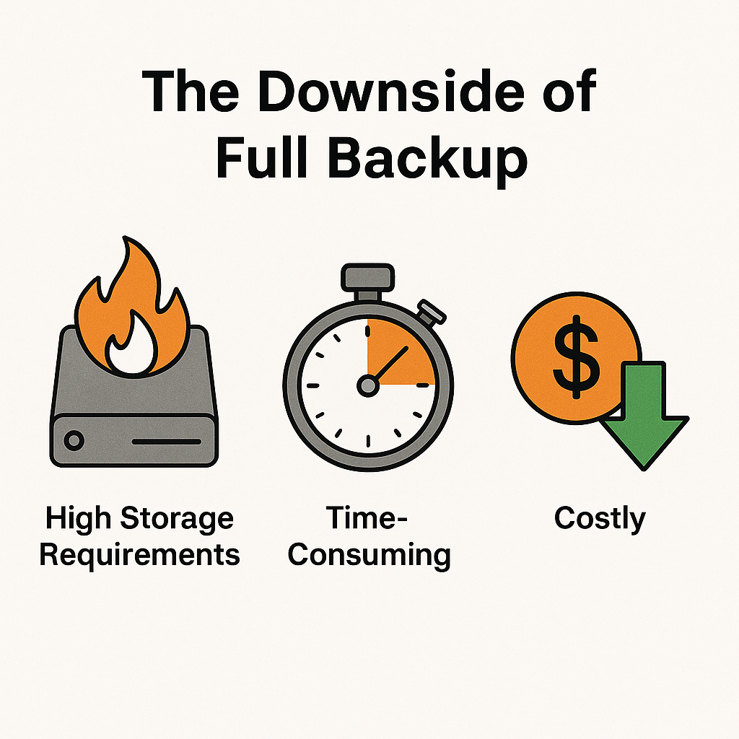
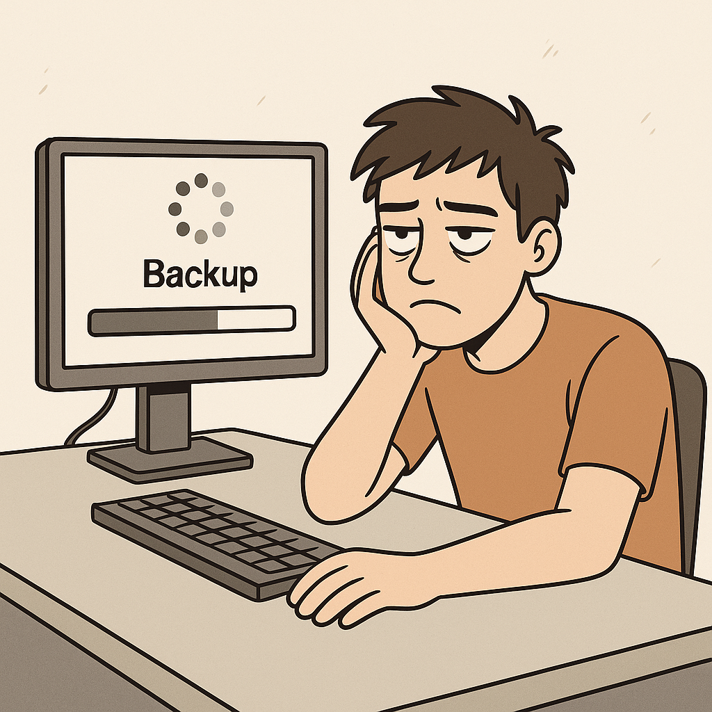
5.Full Backup
The Pros and Cons of making full backup
⚠️ Downsides
High storage consumption
Time-intensive backup process
Slower recovery for large data sets
Increased network bandwidth usage
Higher infrastructure costs
Not ideal for frequent DevOps iterations
✅ Upsides
Complete data snapshot
Simplifies recovery process
Easy to manage (no dependency on other backups)

Slide 15
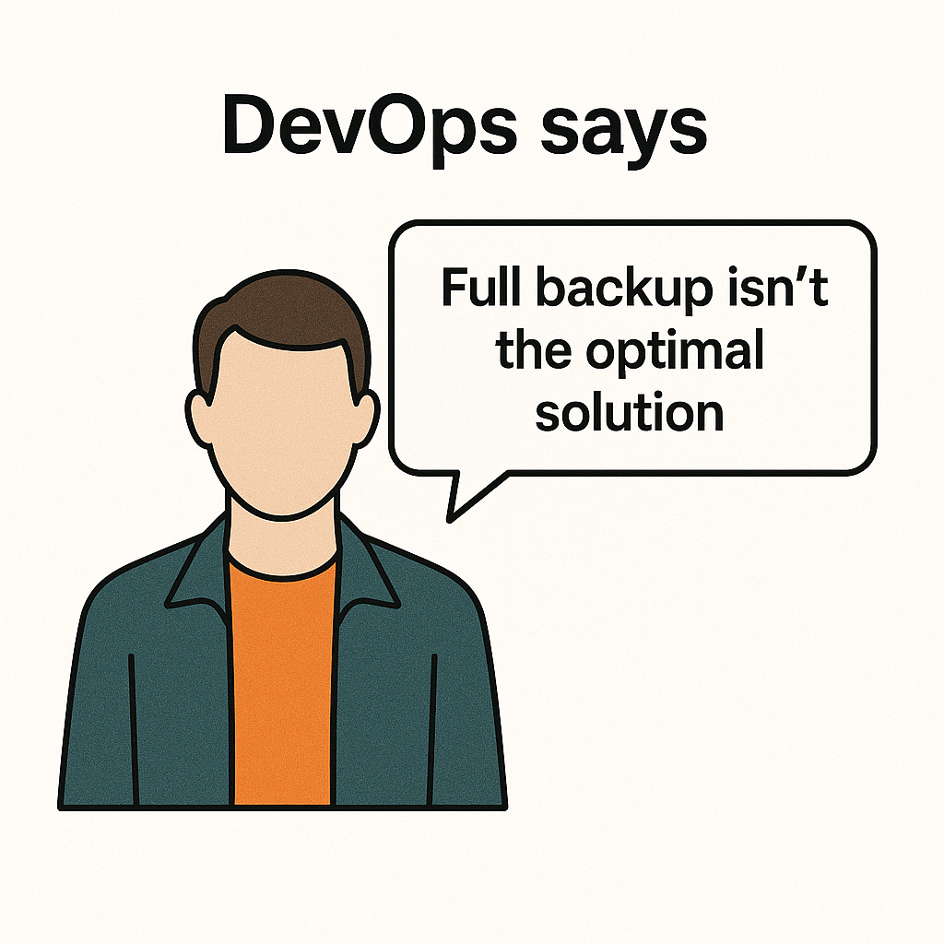
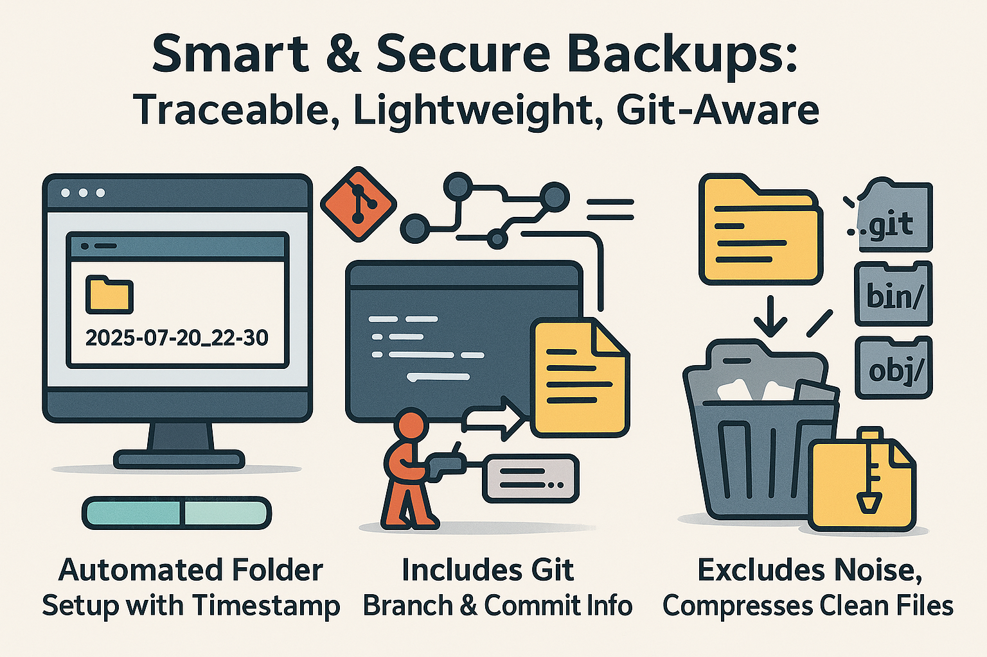

6.Backup Strategy: Smart, Git-Aware & Clean
🔧 What This Part Does
Creates automated timestamped backups of the working directory. Captures Git branch name and latest commit message for traceability. Excludes unnecessary folders like .git, bin/, obj/, and backups to keep the package clean. Why This Matters:
Traceability: Links each backup to a specific point in the Git history.
Cleaner Backups: Removes clutter, keeping only what's needed for deployment rollback.
Time-Saving: Automates a previously manual and error-prone task.
Safety Net: Provides a reliable restore point before major changes or deployments.

Slide 16

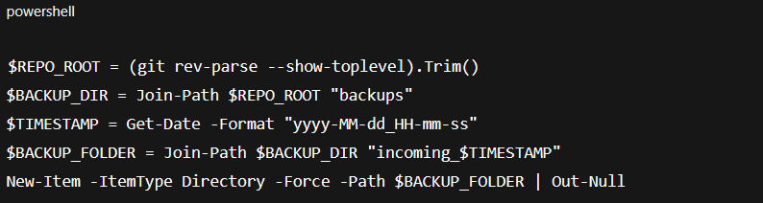
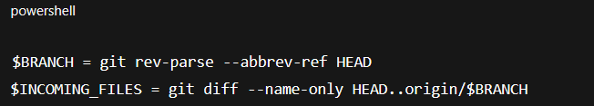
6.Smart and Git-Aware Backup
Define what to back up and where to store it — safely, cleanly, and organized.
Detect only incoming changes

Slide 17
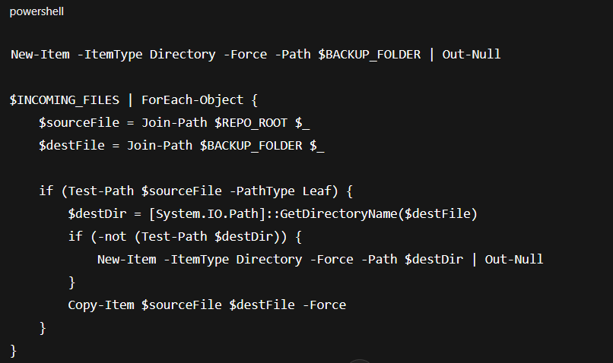


6.Smart and Git-Aware Backup
Create a timestamped backup folder and copies only the incoming changed files into it, preserving their directory structure.

Slide 18
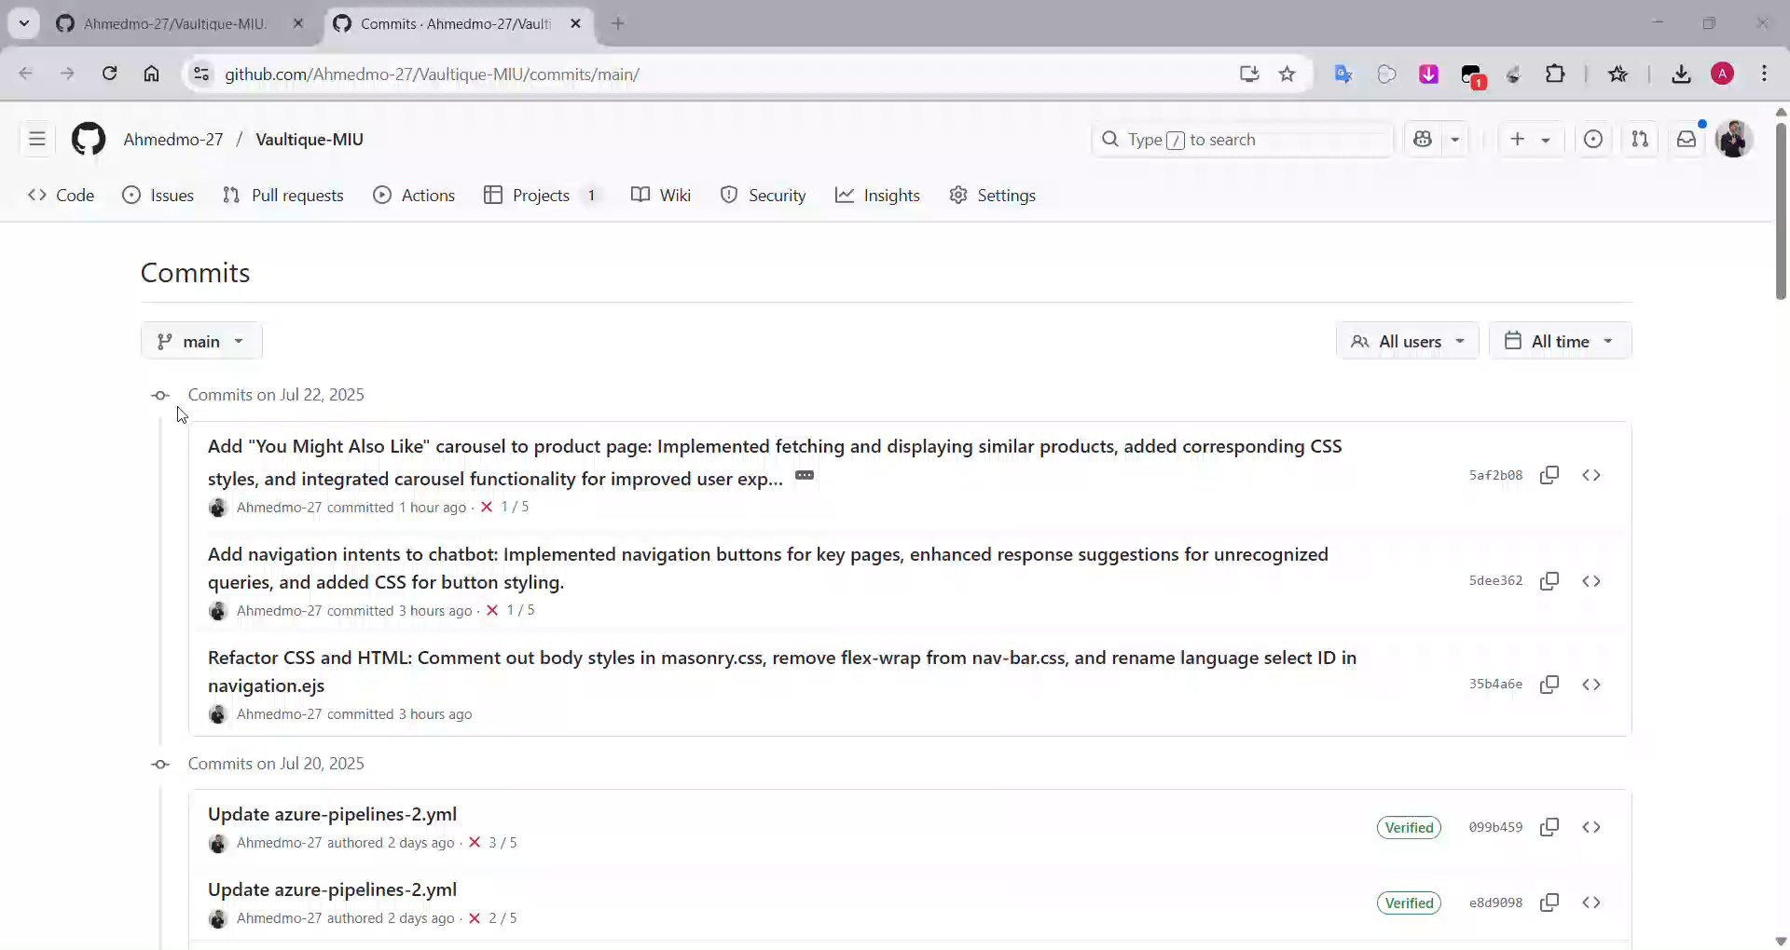
6.Smart and Git-Aware Backup
Demo Video

Slide 19
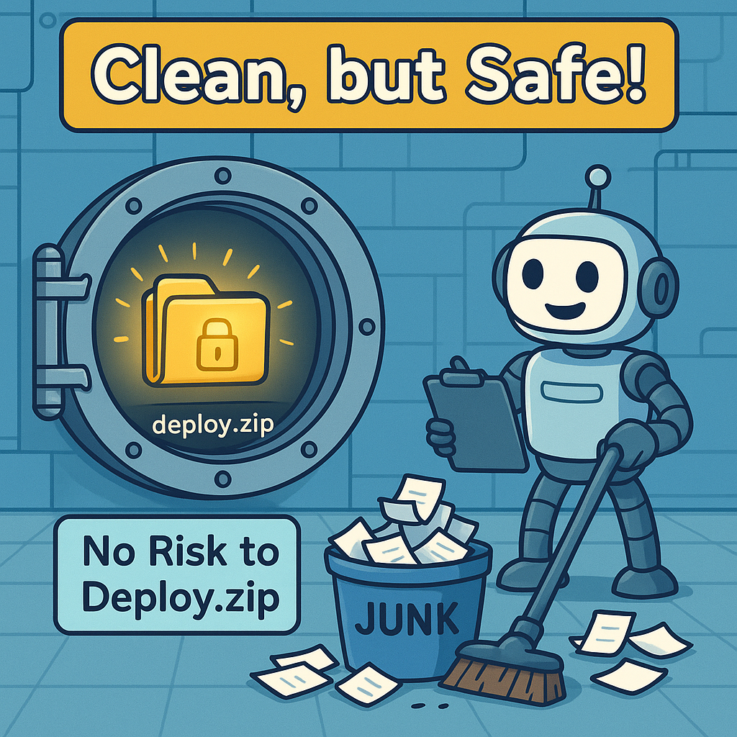
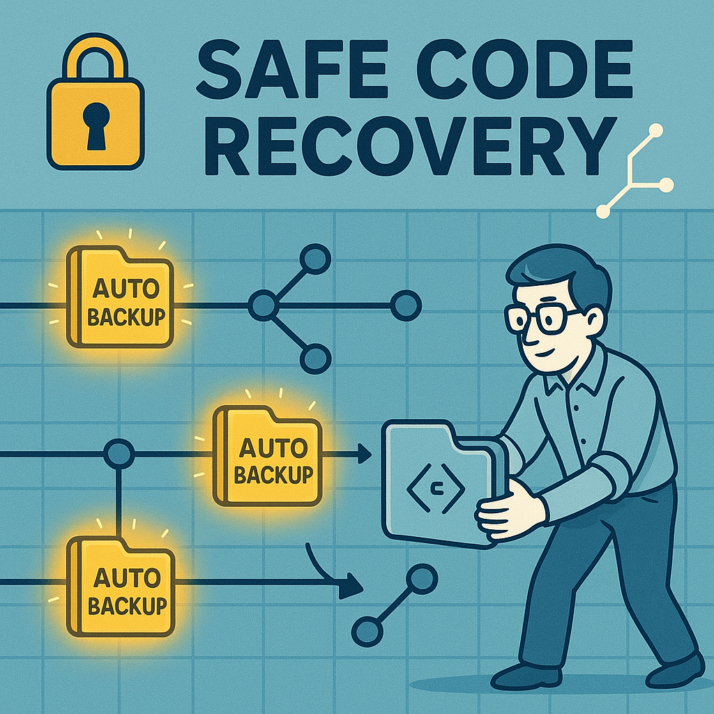
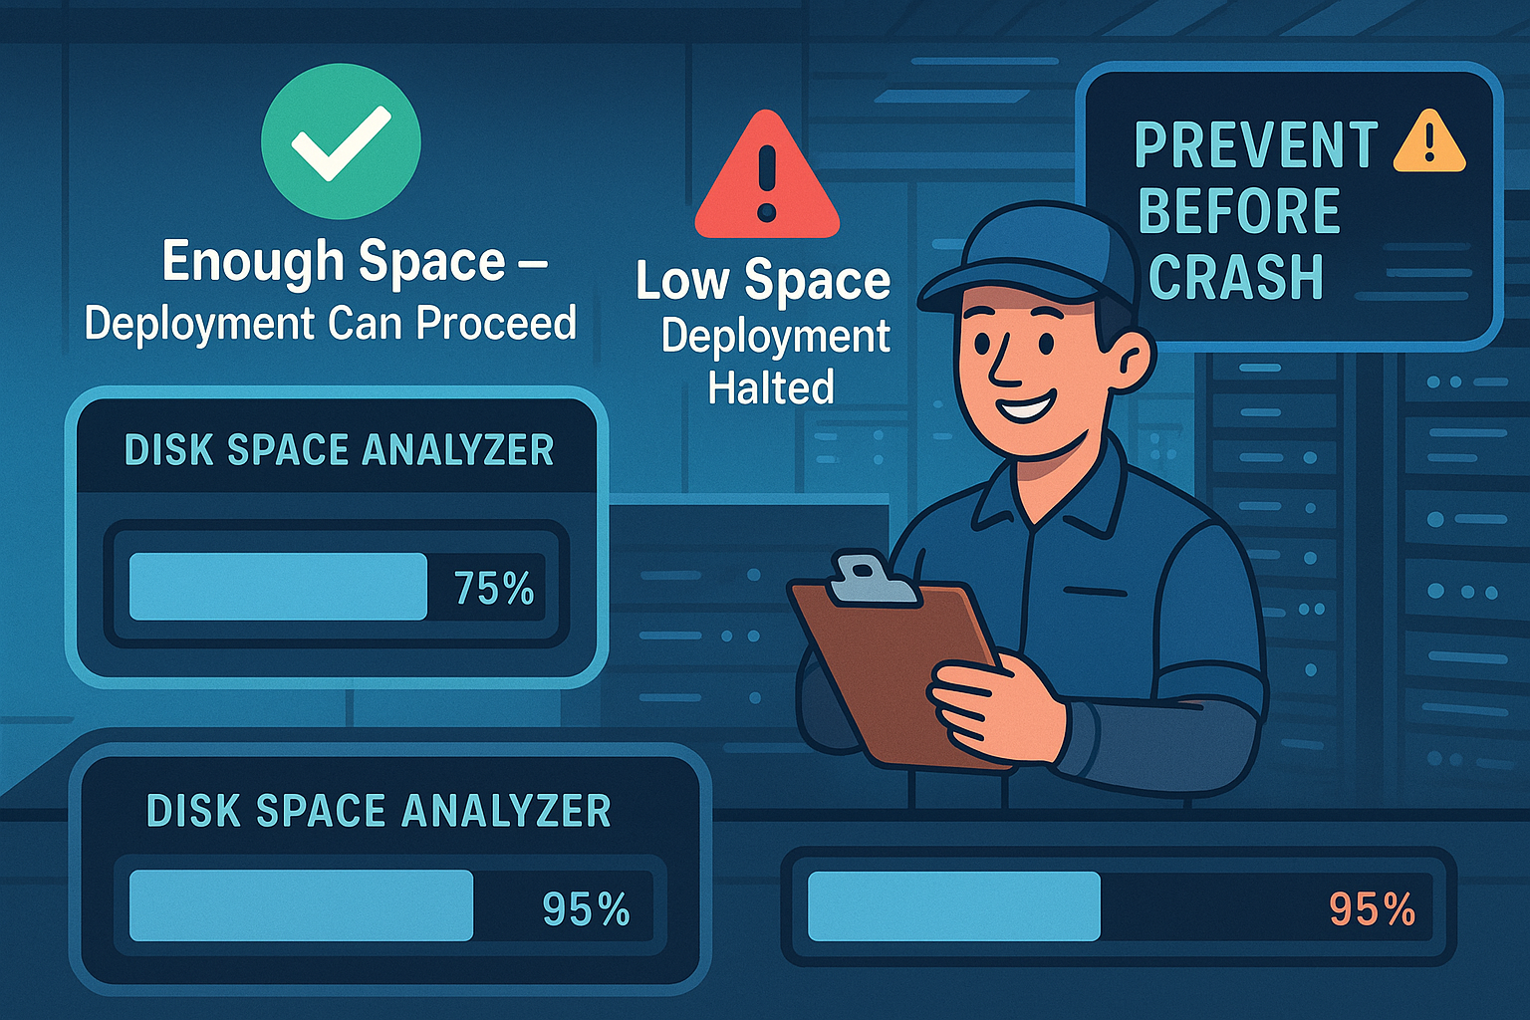
7.Conclusion Streamlined, Safe & Smarter DevOps
1. Smart Space Check Before Deployment
2. Safe Cleanup Practices
3. Git-Aware Backup System
Prevents mid-deployment crashes by ensuring enough disk space before starting the process. Saves teams hours of troubleshooting and rollbacks.
Cleans directories without risking key deployment files, reducing human error and supporting faster, cleaner releases.
Keeps your code and context safe with automatic backups linked to Git history. Helps you roll back confidently at any time.

Slide 20

Thank You

